Slide 1
Recommender System For Nursing Homes
By: Shafiur Chowdhury and Ashwin Verma

Slide 2
Project Objectives
Build a System that can accurately give each nursing home an overall quality rating based off various features
Try to find features graphically that might have influenced our system to give a rating that it did
See what poorly rated nursing homes can do to improve their quality

Slide 3
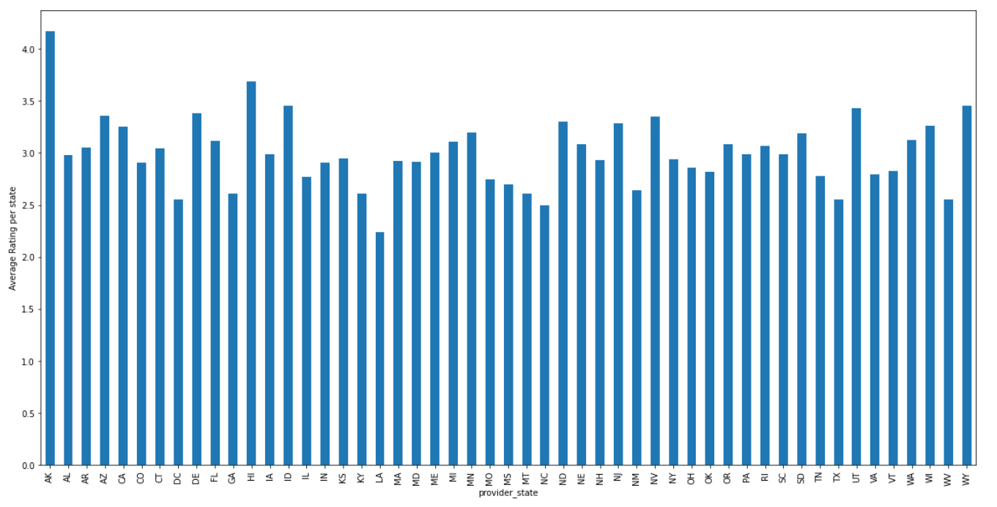
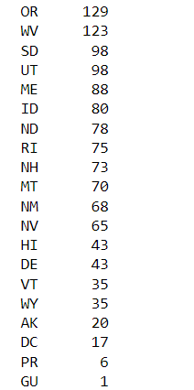
Description Of Data
General information on currently active nursing homes, including number of certified beds, quality measure scores, staffing, and other information used in the Five-Star Rating System.

Slide 4
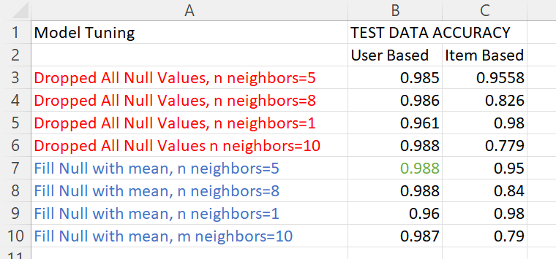
Model Description
Accuracy= good ratings/(good ratings + bad ratings)
Good rating: abs(predicticted-actual) <=1,
Bad Rating: abs(predicticted-actual) >1

Slide 5
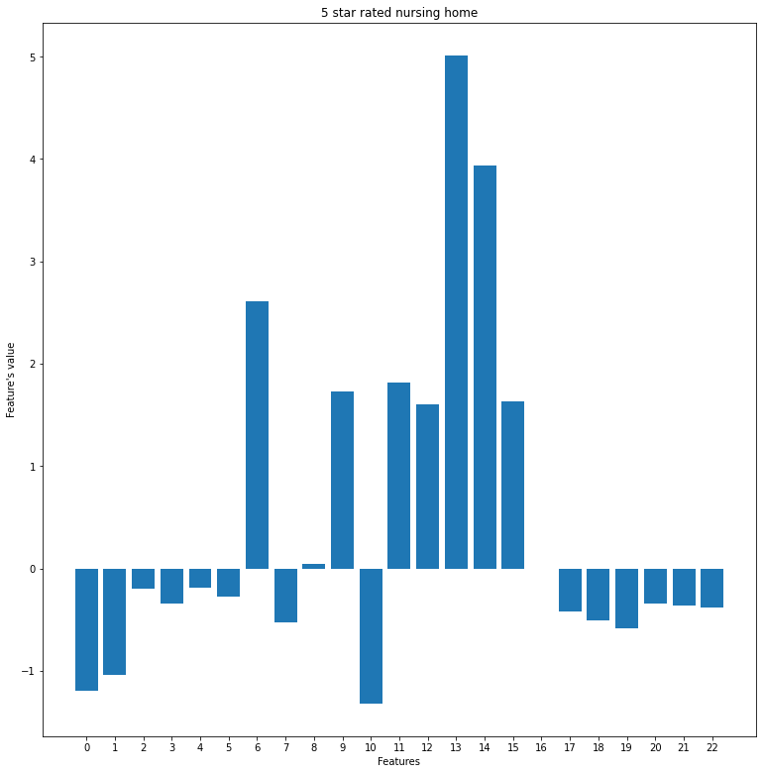
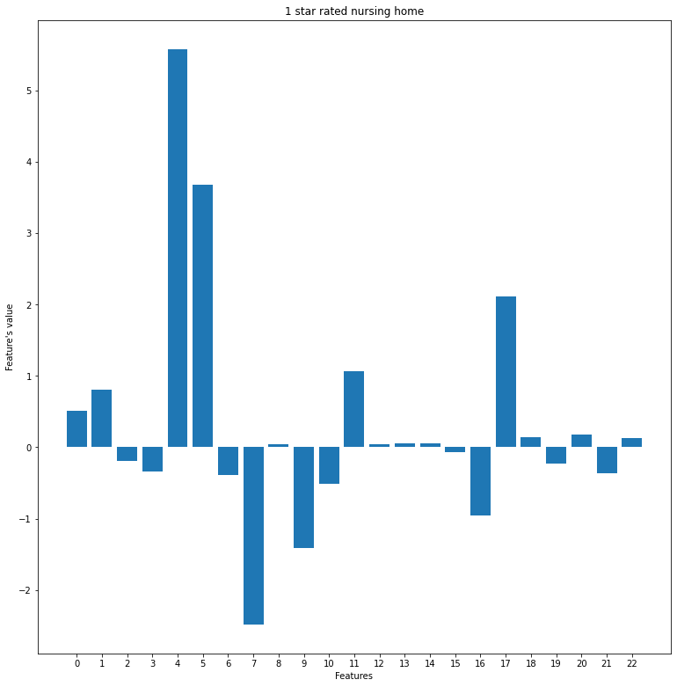
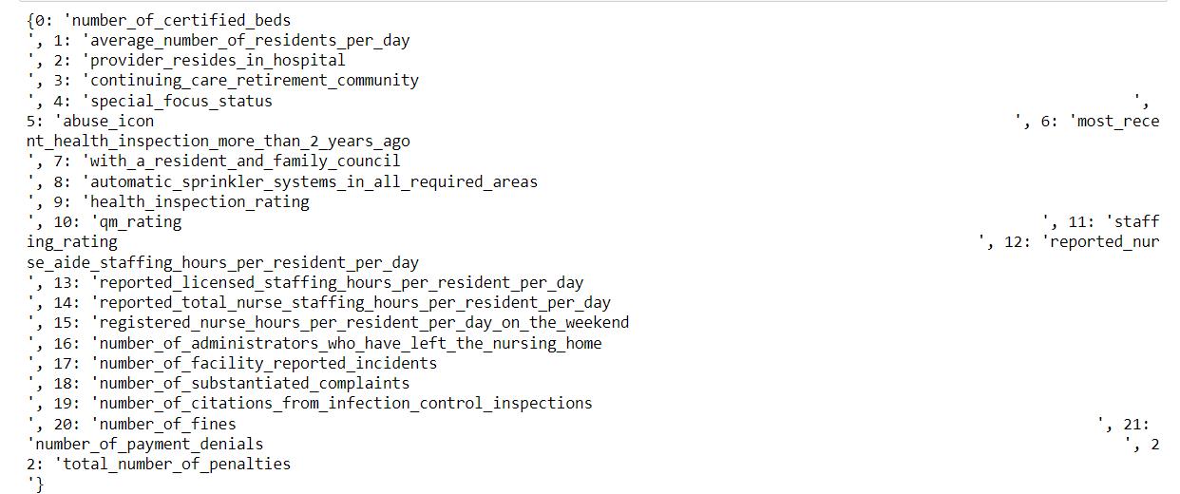
Description Of Results
Graph of 2 random samples that the system predicted exactly correct

